Slide 2
AGENDA
    % of SLA compliance
      A1 applications + components details
      A1 applications by domains
      A2 applications + components details
      Collaboration solutions
    KPIs review
      % of High Severity Incident resolution within SLA
      % of problem resolution at first contact
      % of new PCs delivered within SLA
      Business user satisfaction with SGSI performance (once a year)
      Michelin end user satisfaction with P3 performance
    Problem management
    UXM monitoring
    Action Log review

Slide 3
A1 Applications Summary
    SLA Compliance
    Availability
    Quality Impact
    Outages
    Response Time
    On-time Batch Completion
    Nonconformities

Slide 4
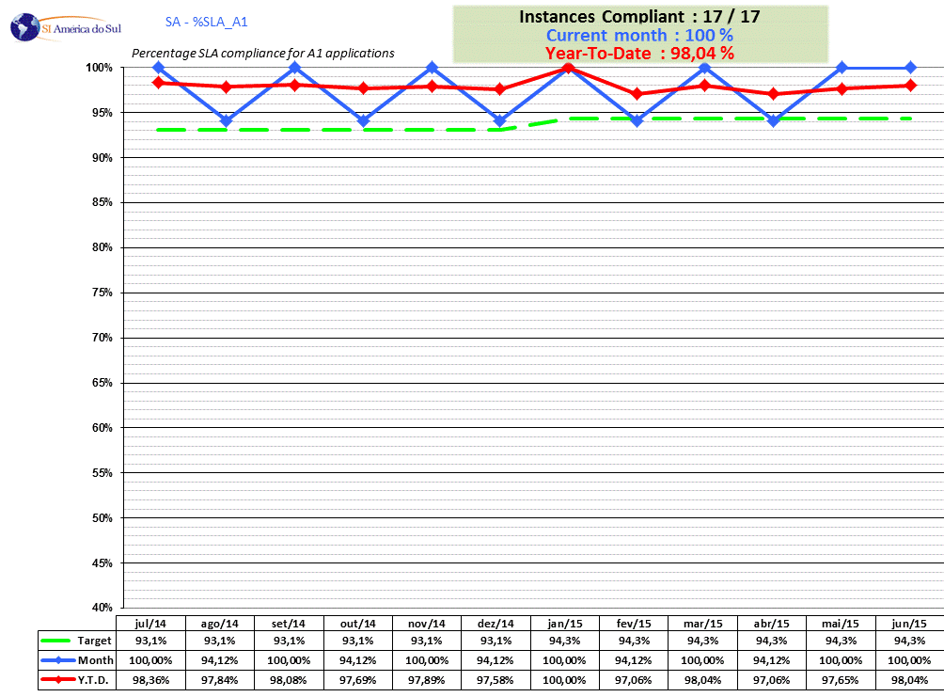
% of SLA compliance forA1 applications

Slide 5
% of SLA compliance for A1 applications by domain
Notes:
Here we will find a new chart with 1 line by domain

Slide 6
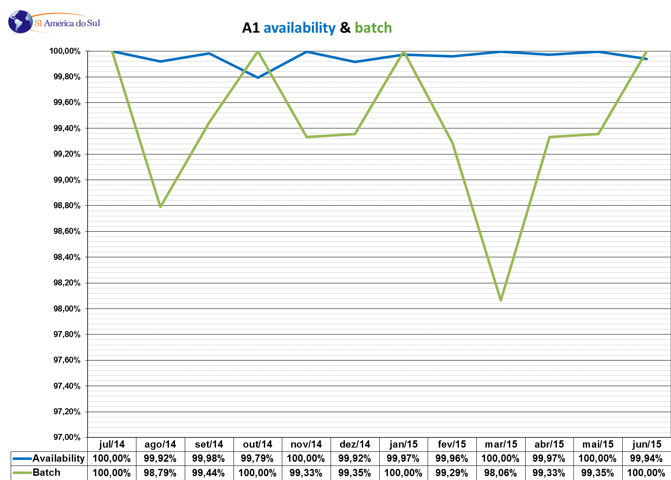
A1 Availability / On Time Batch

Slide 7
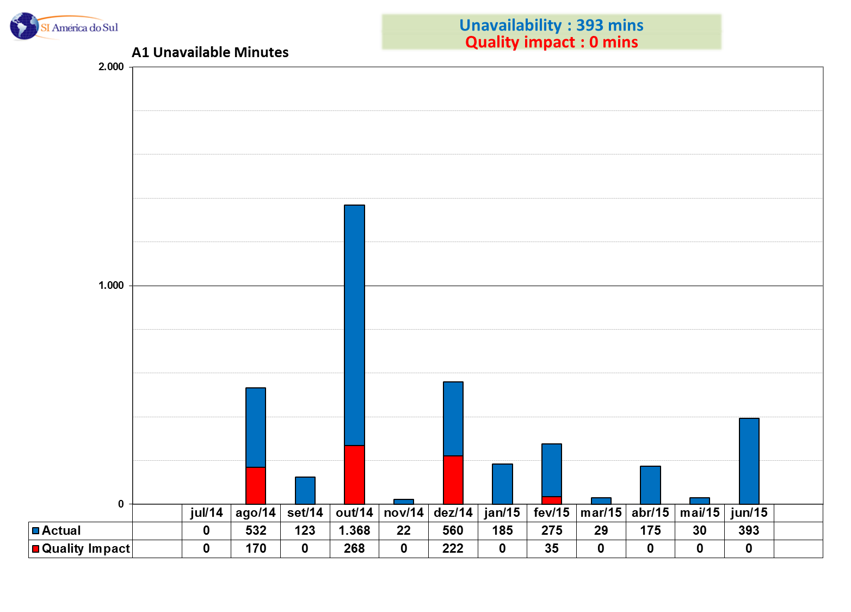
A1 Quality Impact
Notes:
Unavailability
EUR : 2134
NA : 1885
AS : 2459
ZMA : 75

Slide 8
Apps A1 - Unavailability Chart
No changes for July Perf review (hidden slide)

Slide 9
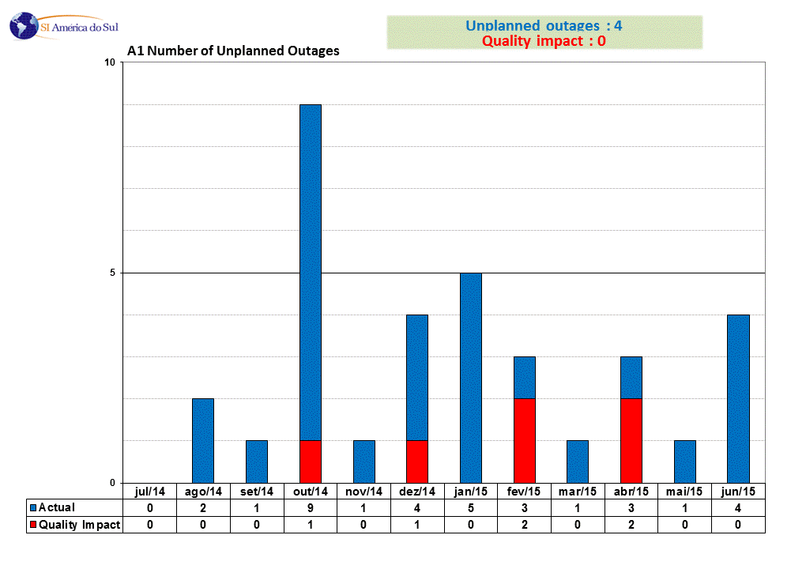
A1 Outages
Notes:
EUR : 24
NA : 12
AS : 11
ZMA : 2

Slide 10
Apps A1 - Outages Chart
No changes for July Perf review (hidden slide)

Slide 11
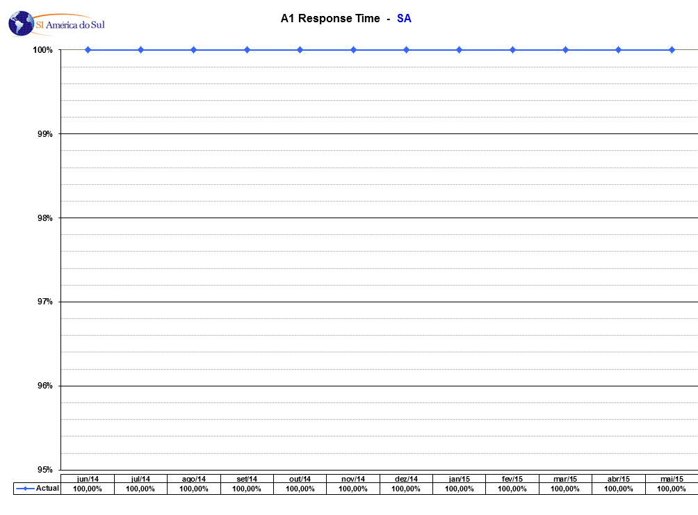
A1 Response Time

Slide 12
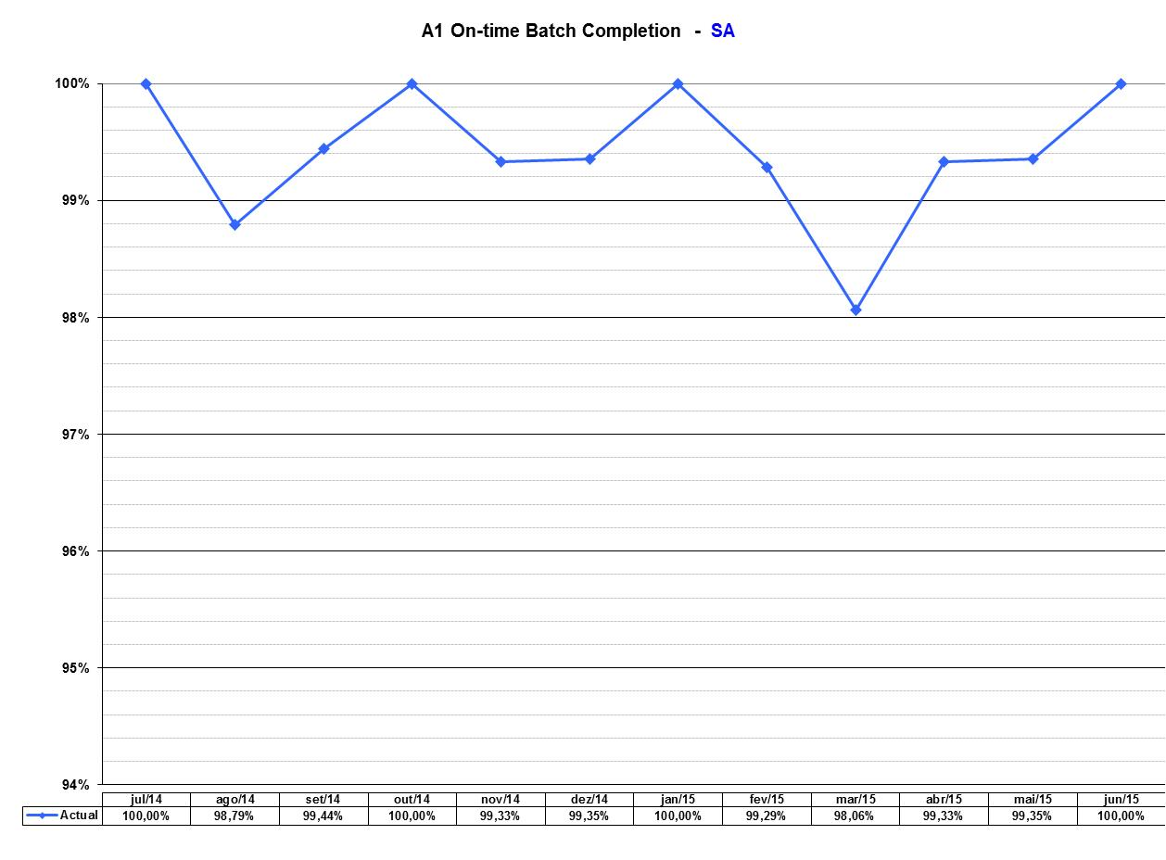
A1 On Time Batch Completion

Slide 13
A1 changes in May
Notes:
Here are the changes in the A1 application list or in targets

Slide 14
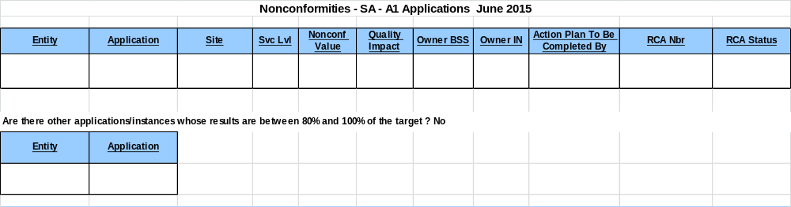
A1 Non Conformities

Slide 15
Nonconformities – SA – A1 Applications – May 2015

Slide 16
Severity 1 incident impacting several A1 SLAs or with a strong impact on business satisfaction

Slide 17
2014 Calculation of the A1 compliance % for South America

Slide 18
A2 Applications Summary
    SLA Compliance
    Availability
    Quality Impact
    Outages
    Response Time
    On-time Batch Completion
    Nonconformities

Slide 19
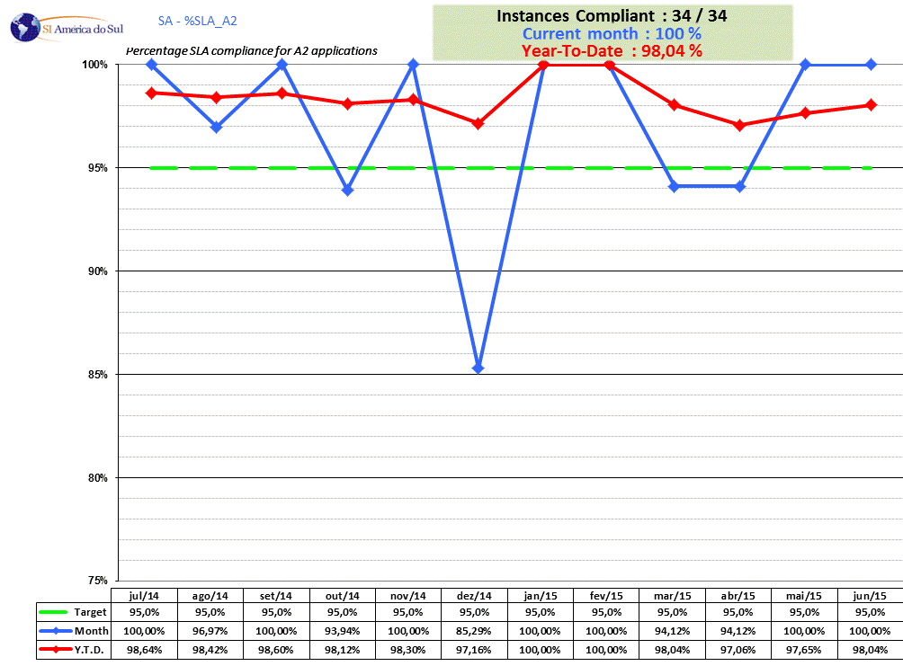
% of SLA compliance for A2 applications by domain

Slide 20
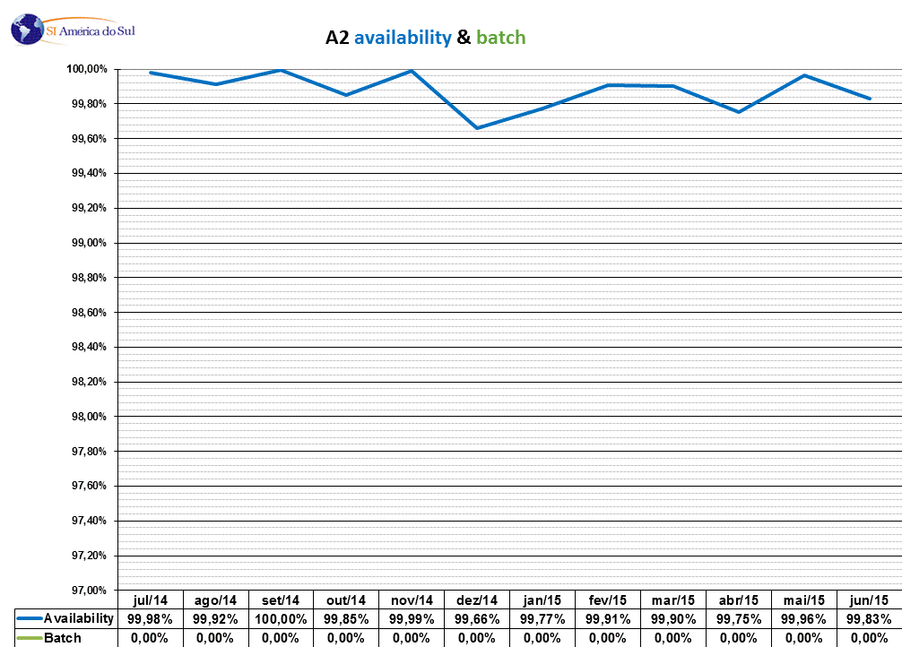
A2 Availability

Slide 21
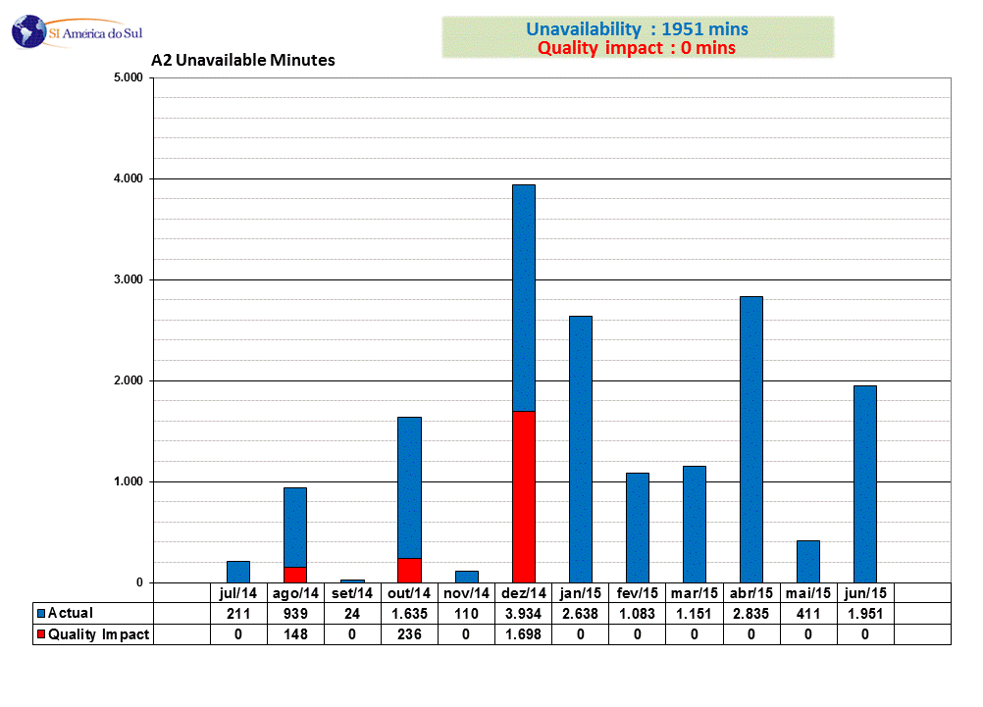
A2 Quality Impact
Notes:
EUR : 3610
NA : 3334
AS : 438

Slide 22
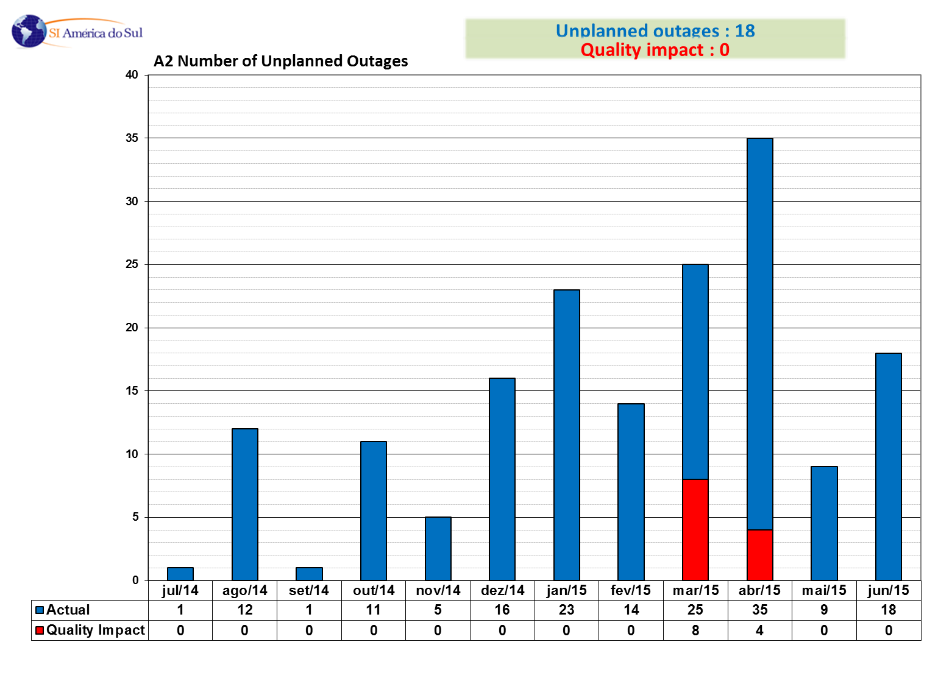
A2 Outages
Notes:
EUR : 61
NA : 19
AS : 4

Slide 23
A2 changes in May

Slide 24
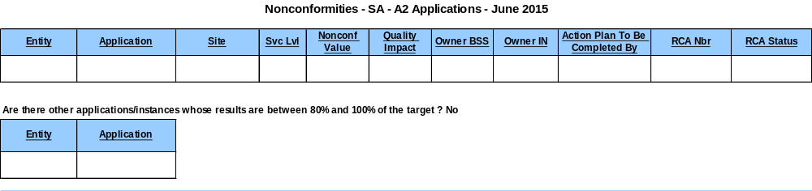
A2 Non Conformities

Slide 25
Nonconformities – SA – A2 Applications – May 2015

Slide 26
Severity 1 incident impacting several A2 SLAs or with a strong impact on business satisfaction

Slide 27
2014 Calculation of the A2 compliance % for South America

Slide 28
Not implemented for July Perf review
Collaboration Solutions Summary
    Global
      %SLA_Col Chart
    E-mail solution : detail
      Inter zone Transit Time
      Intra zone Transit Time

Slide 29
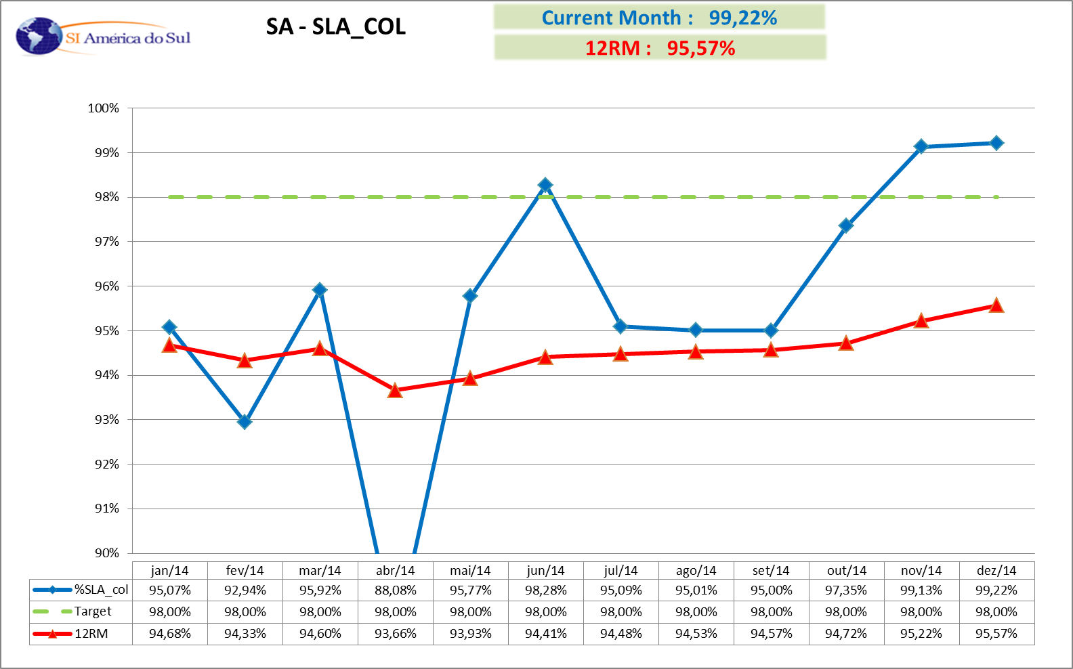
% of SLA compliance for collaboration solutions

Slide 30
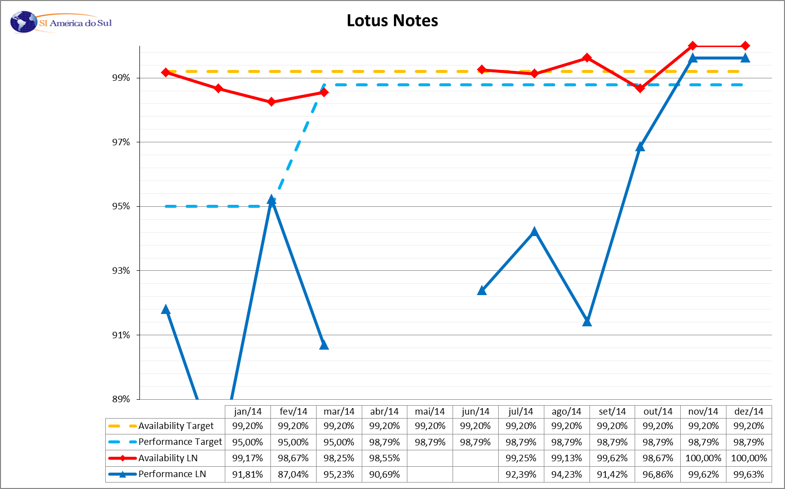
% of SLA compliance for Lotus Notes

Slide 31
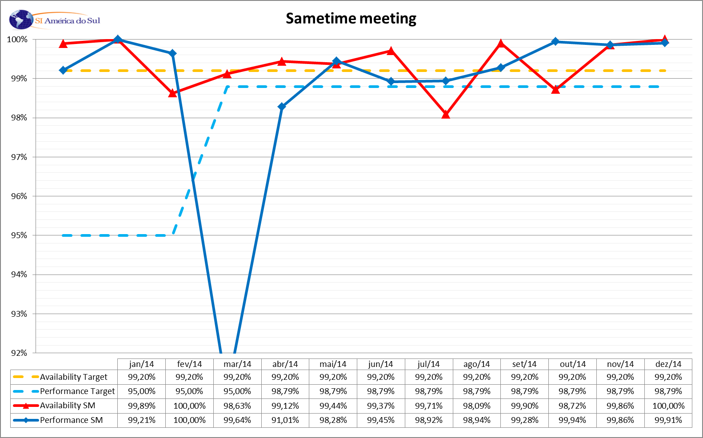
% of SLA compliance for Sametime Meeting

Slide 32
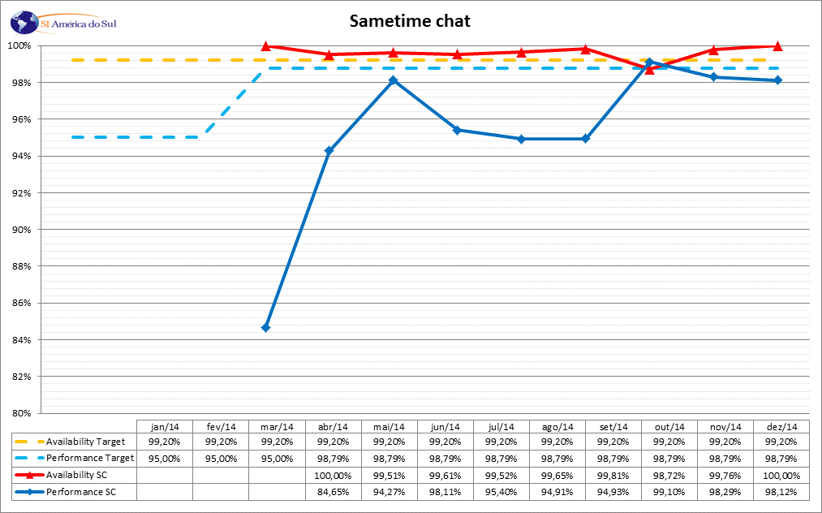
% of SLA compliance for Sametime Chat

Slide 33
Incident Management
    KPIs
    Action Plan / Comment

Slide 34
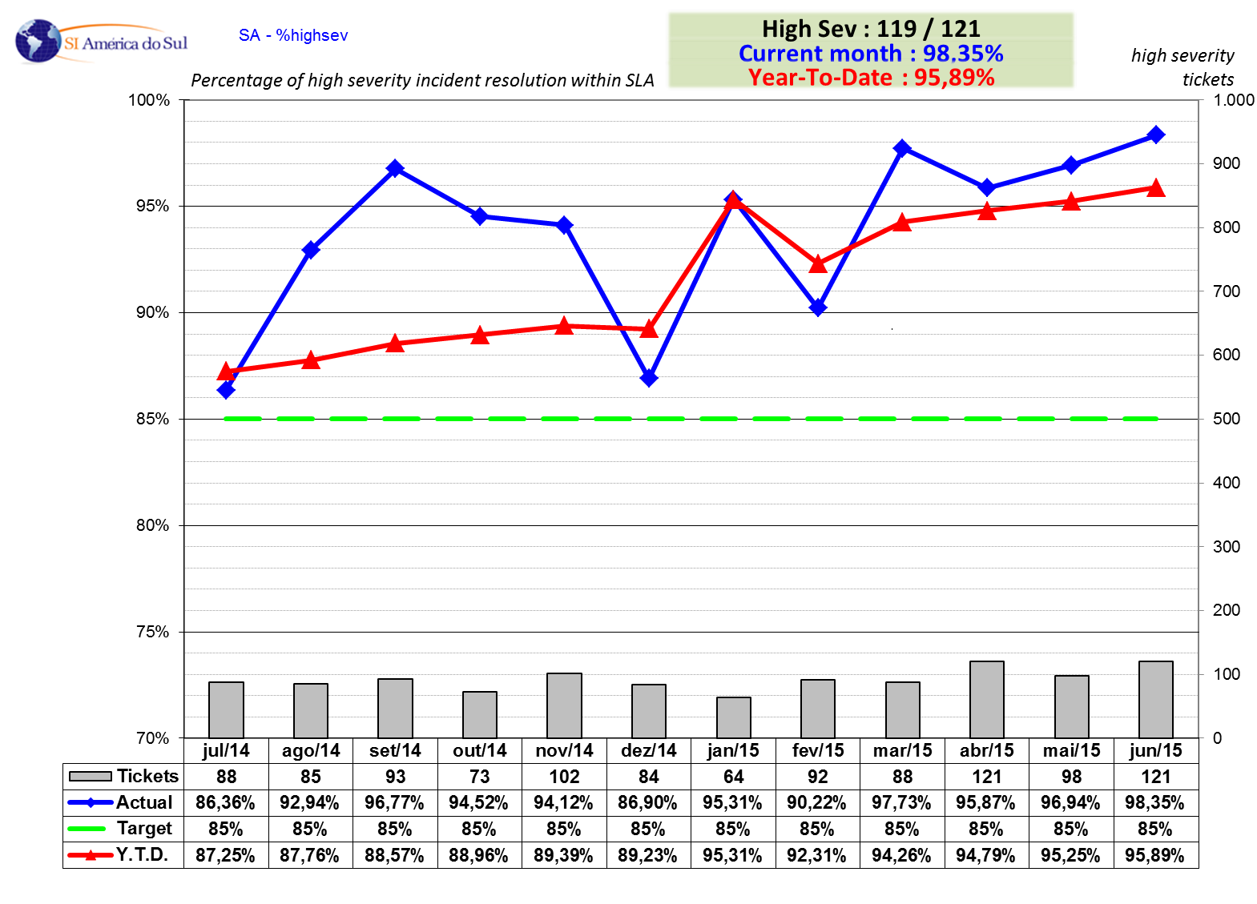
% of High Severity Incident resolution within SLA

Slide 35
%highsev
IBM / Michelin split
No changes for July Perf review (hidden slide)
June 2013

Slide 36
%highsev – Chart
No changes for July Perf review (hidden slide)
IBM resolution

Slide 37
%highsev - Chart
No changes for July Perf review (hidden slide)
MICHELIN resolution

Slide 38
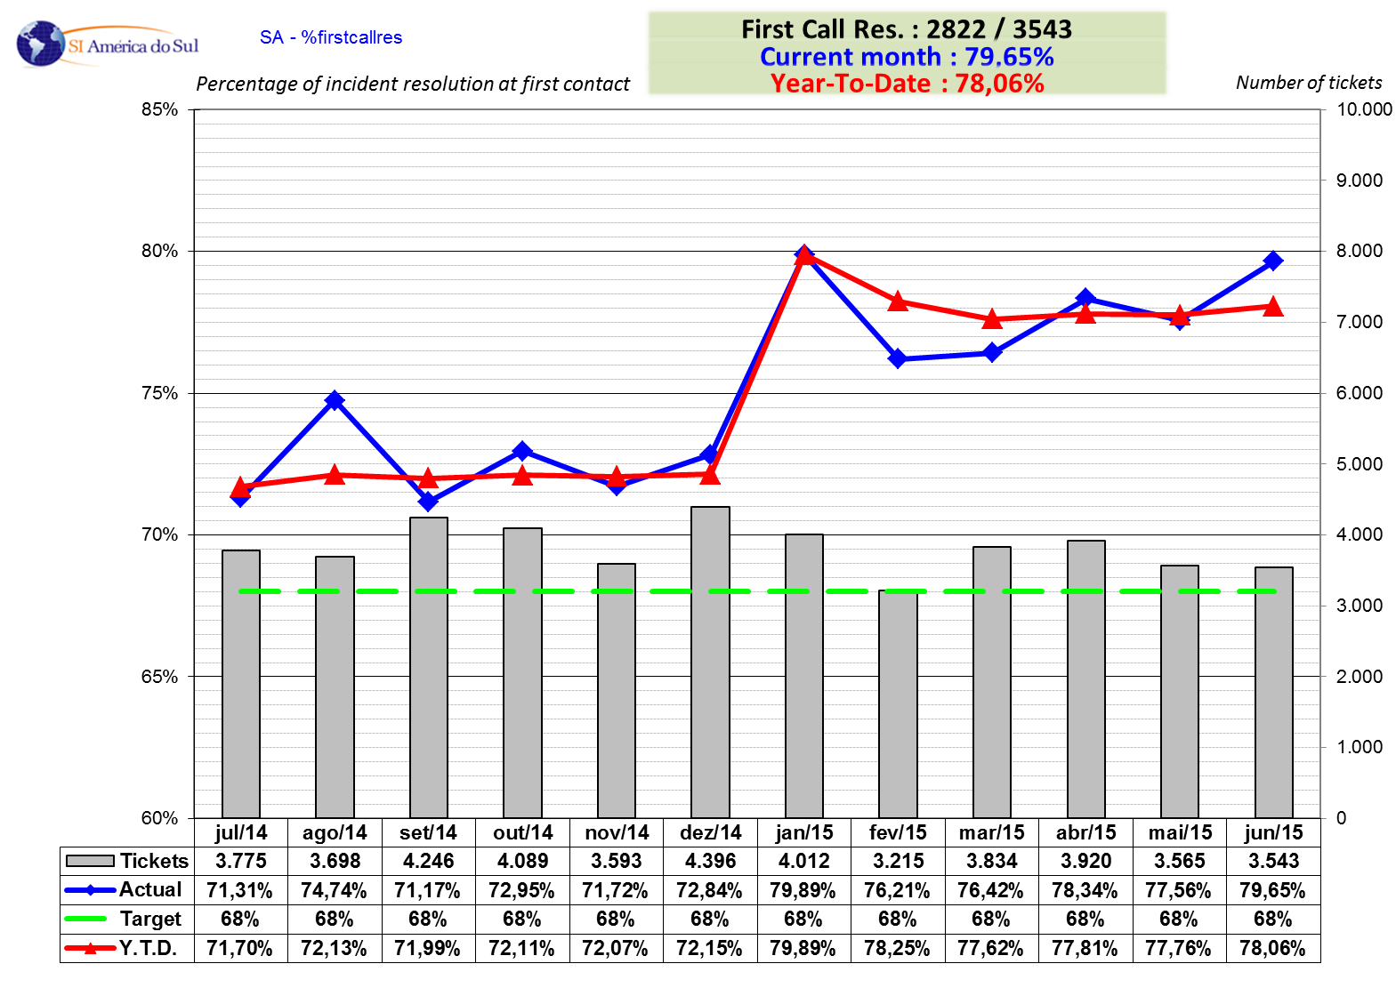
Problem resolution at first contact

Slide 39
%firstcallres - Chart
No changes for July Perf review (hidden slide)

Slide 40
Action Plan / Comment – SA – Incident Management May 2015
Note: Not all text will appear on printed copies of this slide.

Slide 41
Workstations
    Delivery
    Action Plan / Comment

Slide 42
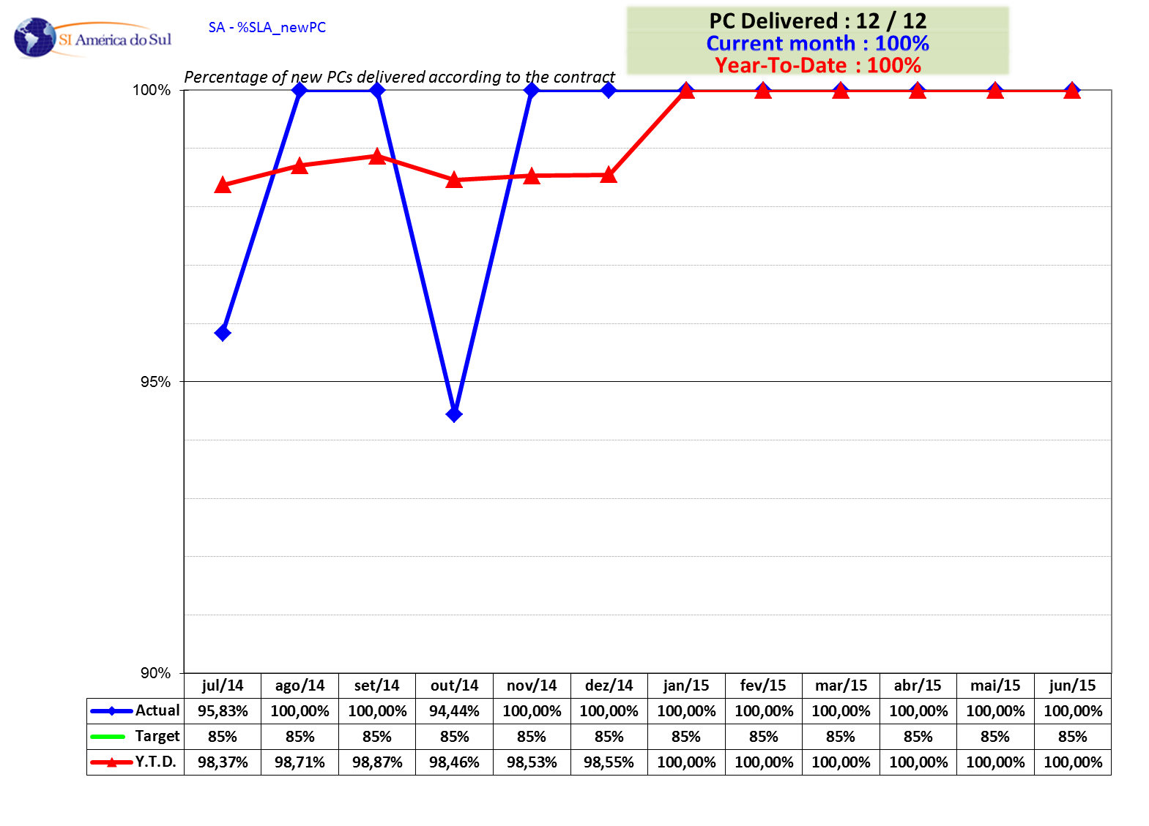
% of new PCs delivered within SLA

Slide 43
Action Plan / Comment – SA – SLA_newPC – May 2015
Note: Not all text will appear on printed copies of this slide.

Slide 44
Business satisfaction

Slide 45
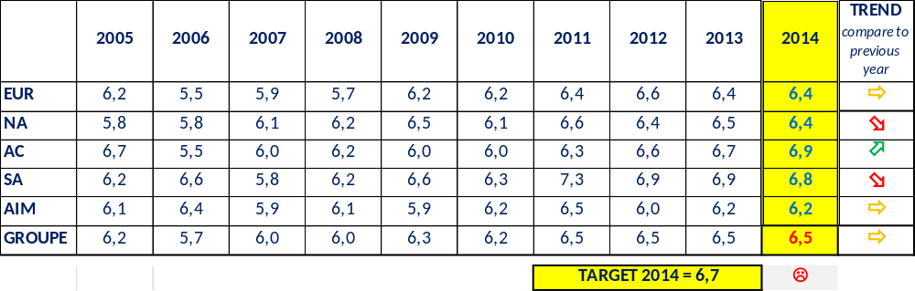
End User

Slide 46
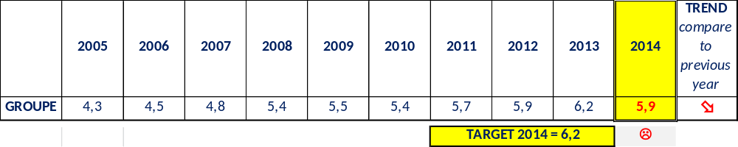
Senior Manager

Slide 47
End User Satisfaction with P3 perf

Slide 48
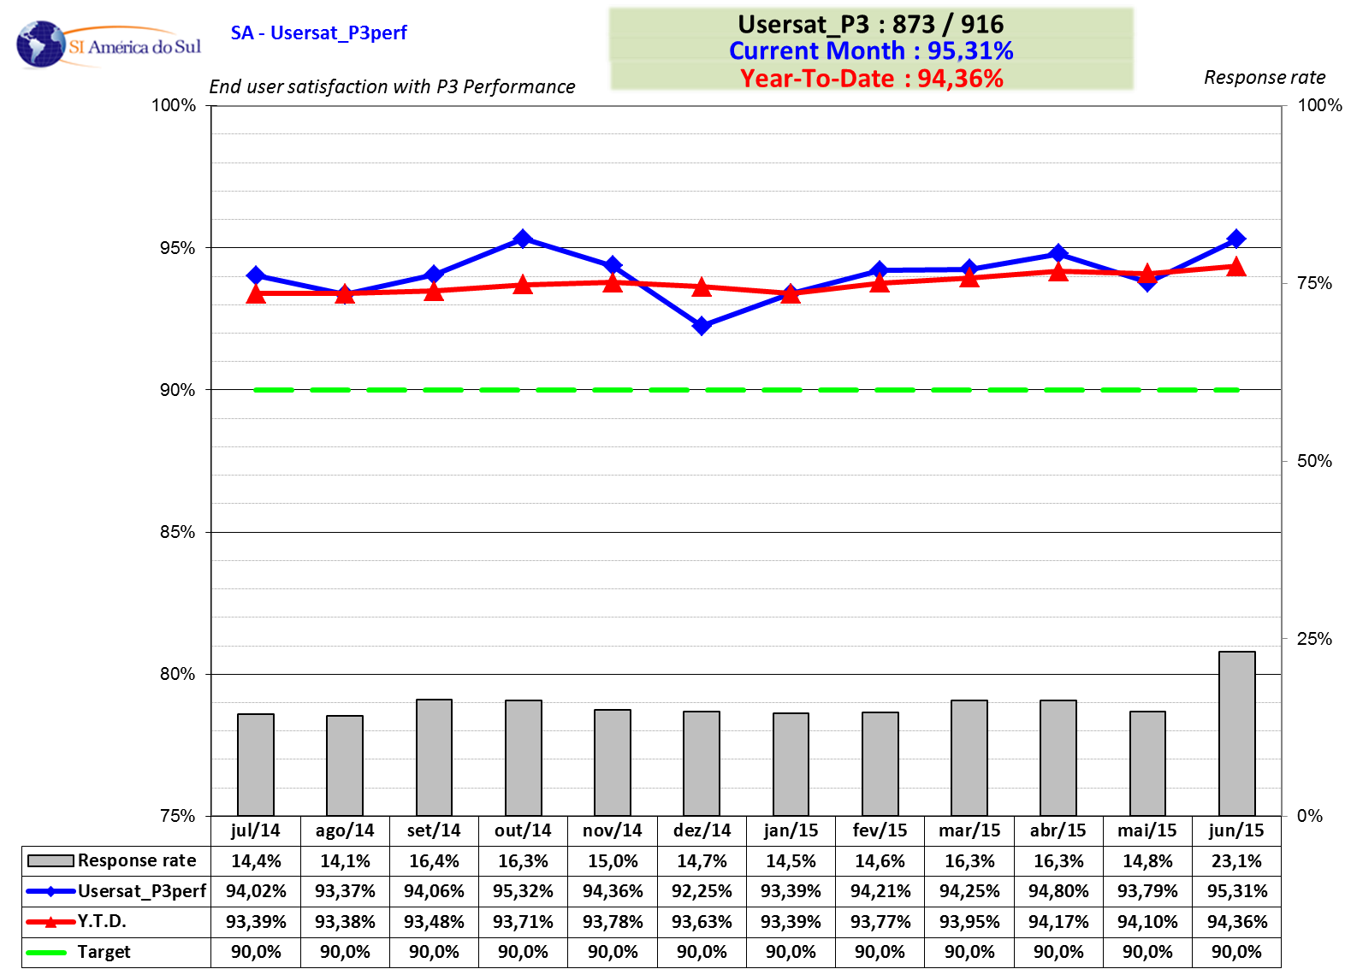
Michelin end user satisfaction with P3 performance

Slide 49
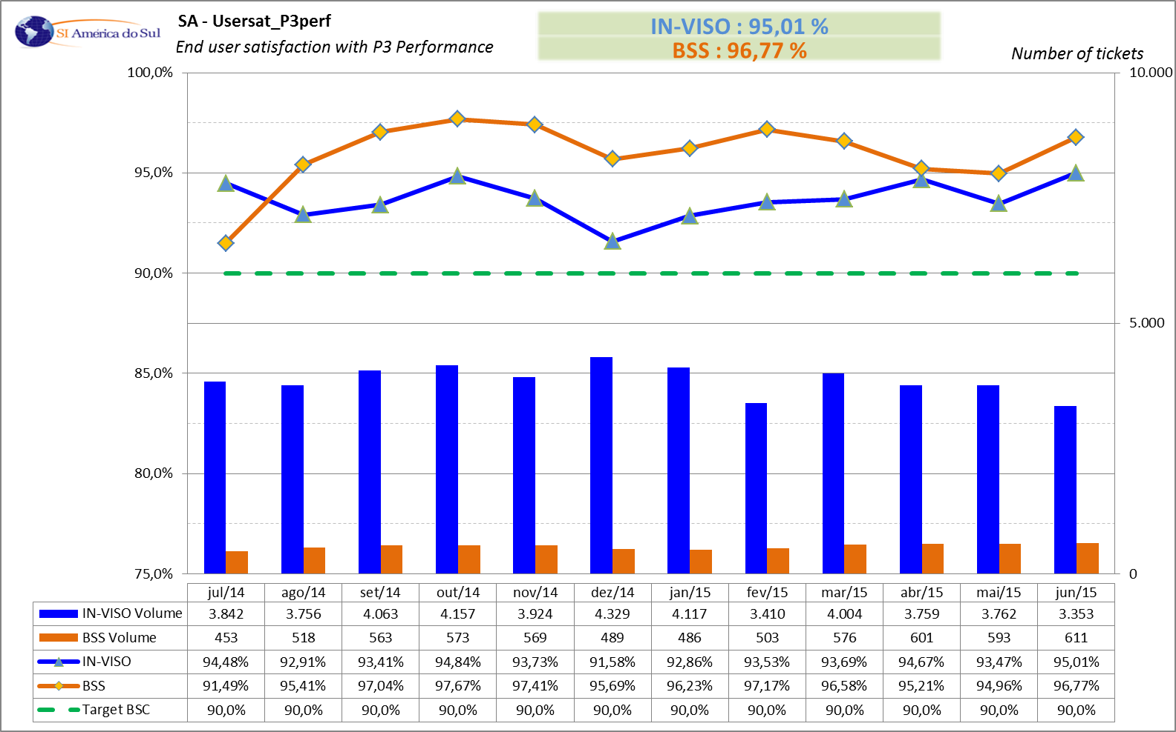
Michelin end user satisfaction with P3 performance - details

Slide 50
Problem Management Follow-up

Slide 51
Problem Management Follow-up
Select and Resolve

Slide 52
Problem Management Follow-up
Implement and Check Results

Slide 53
Problem details
If needed to better explain one or several problems, the zone can add some additional slide(s)

Slide 54
Action Log
(JIRA)

Slide 55

Thanks for your
attention

